Slide 1
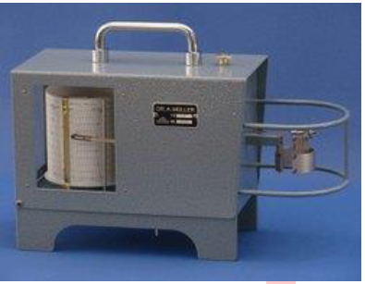

Thermograph & Hygrograph
Thermograph (IS:5901-1970)
This instrument is used for continuously recording the temperature (oc). It is available daily / weekly recording versions and used mechanical / quartz clock drum with compact construction. An aged bimetallic helical coil is used as temperature cause deflection of the coil, resulting in rotating the spindle on which the coil is mounted. The spindle carries a pan arm which records all changes in temperature with respect to time.
Measure: Temperature
Temperature Sensor: Bimetallic Strip
Range : -40°C to 50°C
Accuracy : ± 1°C
1
www.instrumex.ae

Slide 2
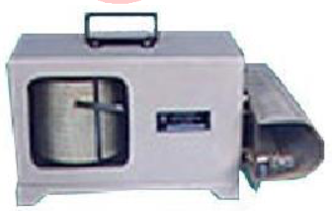
Thermograph & Hygrograph
Hydrograph (IS:5900-1970)
Specifications
Material : Light and durable like aluminum or glass reinforced
polyester for base and
cover and stainless steel or brass for remaining components
Measurement : Humidity
Humidity Sensor : Hair Bundle
Range : 0-100% RH
Accuracy : error should not exceed ±5% above 20% humidity
DUQE Square Business Centre, Quarter
Deck, Queen Elizabeth 2, Mina Rashid,
Dubai (United Arab Emirates)
Represented by
Tel. +971-525829733
E-mail: sales@instrumex.ae
**Drawing/specifications are subjected to change at any time without prior notice as per manufacturing suitability.
2
www.instrumex.ae

